Slide 1
Lecture 6
Dr. Lauren Chenarides
September 30, 2025

Slide 2
Big things have small beginnings. -Spoken by Mr. Dryden in the film Lawrence of Arabia

Slide 3

Lecture 6: Venture Pathways
Textbook Reading (Quiz Basis)
Chapter 7. Pathways to Entrepreneurial Ventures
Lecture Agenda
Pathway 1: Creating a new venture
Pathway 2: Acquiring a business
Pathway 3: Franchising a business

Slide 4
Chapter 7 Objectives
7.1 Describe the major pathways and structures for entrepreneurial ventures.
7.2 Explain the newness dimensions involved in creating a “new venture.”
7.3 Discuss the elements involved in acquiring an established venture.
7.4 Outline 10 key questions to ask when buying an ongoing venture.
7.5 Describe the underlying issues involved in the acquisition process.
7.6 Define a franchise and outline its structure.
7.7 Outline the benefits and drawbacks of franchising.
7.8 Explain the franchise disclosure document (FDD) as a key item in franchises.
7.9 Describe the elements involved with incubators, accelerators, and entrepreneurial ecosystems.

Slide 5
Last week, we covered:
What predicts the performance of successful new ventures?
What are common pitfalls of new ventures?
Why do new ventures fail?
How to test if an idea will work?
What are “low stakes” business models to get your idea off the ground?
Why is legitimacy important for new business ventures?

Slide 6
What IF…
There were other ways to start a business that would flourish overnight?
There was a playbook that allowed your business to overcome some of the common pitfalls attributed to new ventures failure?
This week, we’ll look at three pathways to pursue entrepreneurial ventures:
Create a new business
Acquire a business
Franchise a business

Slide 7
Three Pathways
Entrepreneurs generally enter ventures through three pathways:
Creating a New Venture
Build from scratch, new idea, higher risk but higher control.
Example: launching a farm-based kombucha brand.
Acquiring an Existing Venture
Buy an established business with history, contracts, staff.
Example: purchasing a dairy operation from retiring owners.
Obtaining a Franchise
Buy into a proven business system with support and brand recognition.
Example: running a Subway franchise near a university.
Creating = clearing a new field.
Acquiring = buying a farm.
Franchising = joining a cooperative with shared tools and systems.

Slide 8
Pathway #1 New Venture Creation

Slide 9
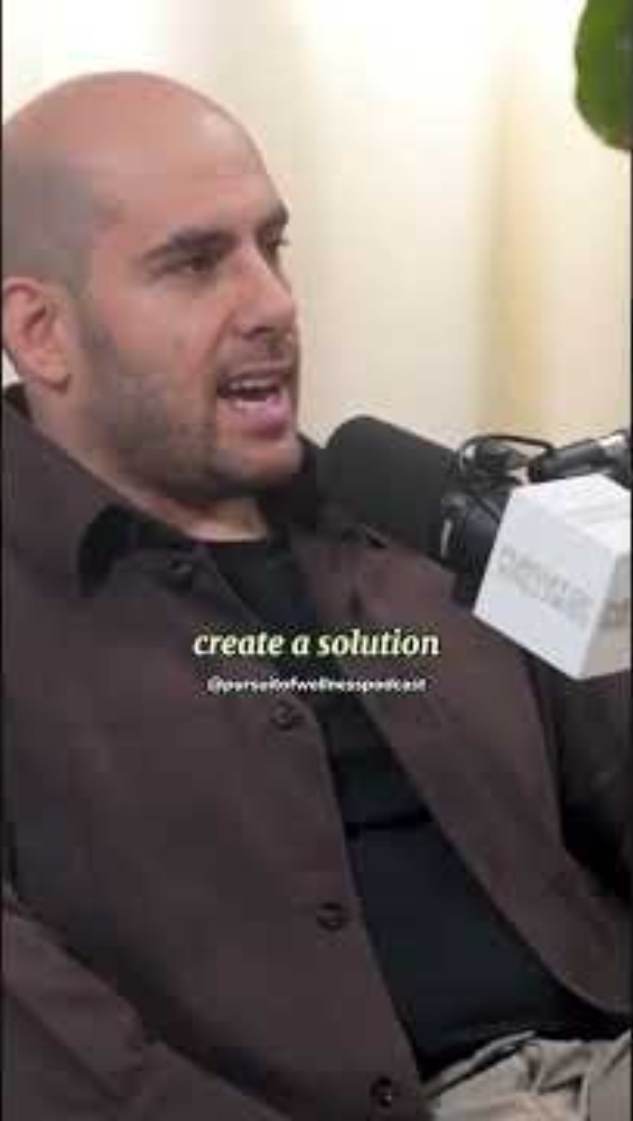
The Story of Sweetgreen
Sweetgreen began as a single salad shop near Georgetown University in 2007.
Value Propositions:
To build healthier communities by providing convenient, fast-casual food that is also healthy, delicious, and sustainable.
Solving the problem of having to choose between fast, cheap, and unhealthy food versus slow, expensive, and fresh food.

Slide 10

The Story of Sweetgreen
Customer Segments:
Health-conscious consumers, particularly those in urban areas and college students.
Individuals seeking convenient and quick meal options who are willing to pay a premium for quality ingredients.
Key Activities:
Developing and preparing a seasonal, plant-forward menu.
Maintaining a transparent supply chain by working directly with farmers.
Using technology to enhance the customer experience through a mobile app for ordering and delivery.
Investing in automation and new kitchen technology to increase efficiency (e.g., the "Infinite Kitchen" concept).

Slide 11
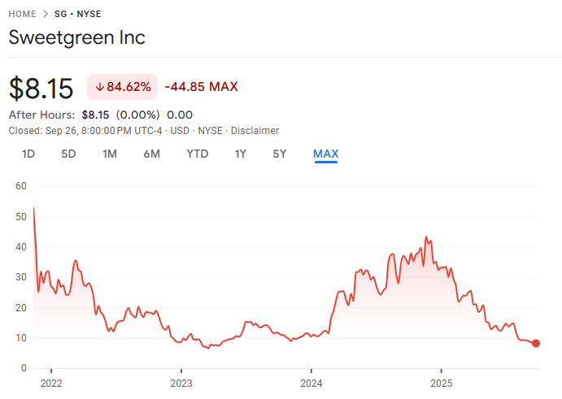
The Story of Sweetgreen
Revenue Streams:
Sales from in-store and online orders of salads and warm bowls.
Delivery service revenue through their owned app.
Catering for corporate offices.
Recent Challenges (as of Q2 2025):
Experiencing a decline in same-store sales and customer traffic.
Operating with a wider net loss than the previous year.
The stock price is volatile, recently hitting a 52-week low.

Slide 12
Creating New Ventures
When entrepreneurs decide to start a new venture, they usually think about how their idea is positioned relative to what already exists.
Two major approaches are outlined in the textbook:
the New-New Approach
the New-Old Approach

Slide 13
New-New Approach
This involves identifying something that does not yet exist in the marketplace and creating it from scratch.
It requires observation of unmet needs, frustrations, or inefficiencies in daily life.
In agribusiness, this might mean developing entirely new technologies or services.
For example, farmers creating smartphone apps that integrate satellite imagery with irrigation scheduling bring a brand-new solution that did not exist previously.
These ventures often carry high risk because customers are unfamiliar with the product or service, but they can also yield high rewards if the market embraces the innovation.

Slide 14
New-Old Approach
This approach adapts, improves, or extends an existing product, service, or business concept.
Entrepreneurs take something that already works somewhere else and modify it to suit a new context or provide added value.
In agribusiness, this could include adapting the Community Supported Agriculture (CSA) model by offering customizable subscription boxes.
While not as radical as the New-New Approach, the New-Old Approach can be easier for customers to understand and adopt since it builds on familiar concepts, but it still allows differentiation through quality, service, or market reach.

Slide 15
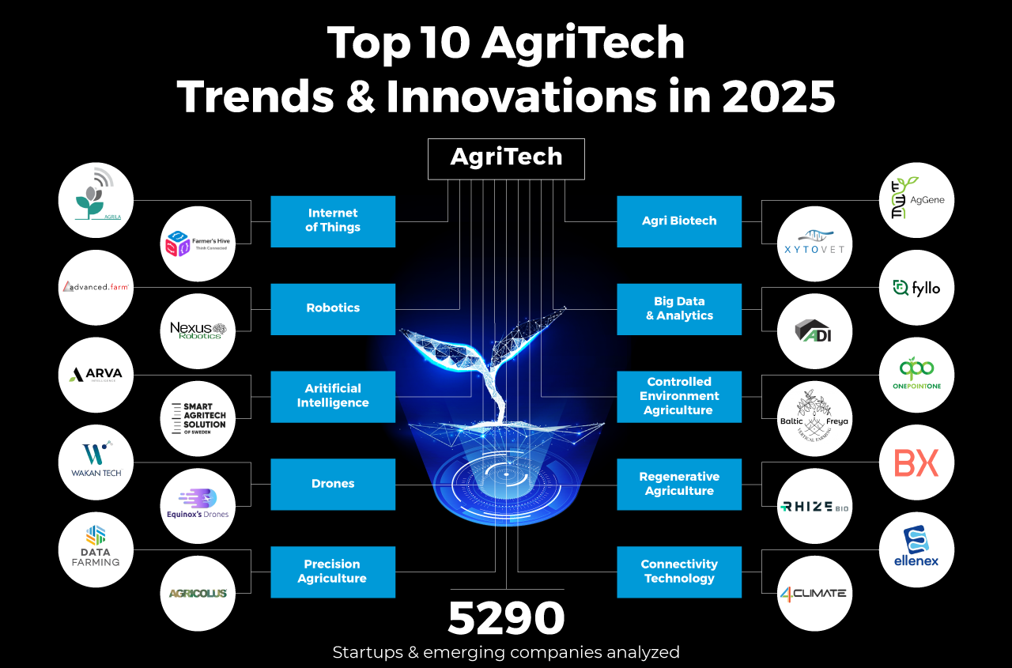
Trends in Agri-Business Startups
Sample of 5290 global startups & scaleups were analyzed to reveal technology advances (automation, drones, biotech) driving most innovation.
Source: StartUs Insights (2025)
Notes:
Table 6.1
Source: Karl H. Vesper, New Venture Strategies, (Revised Edition), 1st Edition, © 1990. Reprinted by permission of Pearson Education, Inc., Upper Saddle River, NJ.

Slide 16
A Newness Framework for New Ventures
The textbook introduces a framework to help us think about how "new" a venture really is.
Newness can be described along two dimensions: the degree of market disruption and the degree of technological advance.
Market Disruption
Technological Advances
A venture may cause only incremental change in existing markets, or it may radically disrupt them.
Incremental disruption might mean offering slightly better service, lower prices, or a modestly improved product.
Radical disruption involves changing how an entire industry operates or creating a completely new market segment.
Ventures may rely on incremental improvements in technology.
Examples include upgrading an existing irrigation system
Alternatively, radical advances like inventing vertical farming systems that allow crops to be grown without soil or sunlight.
Notes:
Placing these two dimensions on axes creates four quadrants. Each quadrant reflects a different type of venture:
Quadrant A (Incremental Tech + Incremental Market):
Small improvements in both technology and the way products are sold.
Example: A farm improves efficiency by using drip irrigation rather than flood irrigation.
Quadrant B (Incremental Tech + Radical Market):
Uses existing technology but introduces it to a completely new market.
Example: Traditional farming methods applied to create a new niche for organic produce in urban areas.
Quadrant C (Radical Tech + Incremental Market):
Applies a major new technology to an existing market.
Example: Introducing drones or AI-driven sensors into conventional crop monitoring.
Quadrant D (Radical Tech + Radical Market):
The most transformative ventures, using breakthrough technology to create an entirely new market.
Example: Vertical hydroponic farms inside city warehouses supplying fresh greens year-round.

Slide 17
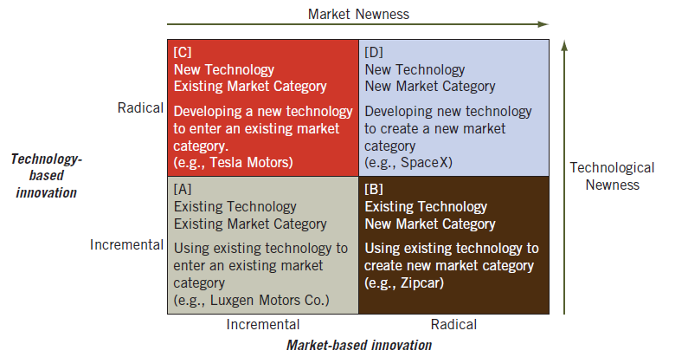
Entrepreneurial Newness Framework
Source: Donald F. Kuratko, Greg Fisher, James M. Bloodgood, and Jeffrey S. Hornsby, “The Paradox of New Venture Legitimation within an Entrepreneurial Ecosystem,” Small Business Economics, 49 vol. 1 (2017): 124.

Slide 18
Entrepreneurial Newness Framework
This framework helps entrepreneurs and investors gauge:
How bold or incremental a venture is?
What risks and opportunities might come with that positioning?
[C] Radical-Incremental Applies a major new technology to an existing market. Example: Introducing drones or AI-driven sensors into conventional crop monitoring. | [D] Radical-Radical The most transformative ventures, using breakthrough technology to create an entirely new market. Example: Vertical hydroponic farms inside city warehouses supplying fresh greens year-round.
[A] Incremental-Incremental Small improvements in both technology and the way products are sold. Example: A farm improves efficiency by using drip irrigation rather than flood irrigation. | [B] Incremental-Incremental Uses existing technology but introduces it to a completely new market. Example: Traditional farming methods applied to create a new niche for organic produce in urban areas.
Notes:
Placing these two dimensions on axes creates four quadrants. Each quadrant reflects a different type of venture:
Quadrant A (Incremental Tech + Incremental Market):
Small improvements in both technology and the way products are sold.
Example: A farm improves efficiency by using drip irrigation rather than flood irrigation.
Quadrant B (Incremental Tech + Radical Market):
Uses existing technology but introduces it to a completely new market.
Example: Traditional farming methods applied to create a new niche for organic produce in urban areas.
Quadrant C (Radical Tech + Incremental Market):
Applies a major new technology to an existing market.
Example: Introducing drones or AI-driven sensors into conventional crop monitoring.
Quadrant D (Radical Tech + Radical Market):
The most transformative ventures, using breakthrough technology to create an entirely new market.
Example: Vertical hydroponic farms inside city warehouses supplying fresh greens year-round.

Slide 19
Group Activity 6-1
Each student gets a card. Each suit corresponds to a quadrant:
Hearts: Quadrant A (Incremental Technology, Existing Market)
Diamonds: Quadrant B (Incremental Technology, New Market)
Clubs: Quadrant C (Radical Technology, Existing Market)
Spades: Quadrant D (Radical Technology, New Market)
Sit with your suit.
Each group receives a scenario and must analyze it, then explain why it belongs in their assigned quadrant.
Notes:
Quadrant A (Hearts – Incremental Tech, Existing Market):
A local dairy farm invests in a slightly more efficient milking machine that reduces time per cow by 10%. The farm continues to sell milk to the same regional processor.
Quadrant B (Diamonds – Incremental Tech, New Market):
A traditional vegetable farm begins packaging its produce in ready-to-eat snack packs for busy urban professionals, using existing farming methods but targeting a new market.
Quadrant C (Clubs – Radical Tech, Existing Market):
A grain farm adopts autonomous tractors powered by AI to plant and harvest crops, disrupting how operations are conducted but still selling into the established commodity grain market.
Quadrant D (Spades – Radical Tech, New Market):
A startup develops indoor aquaponic systems in shipping containers, allowing fish and vegetables to be raised together and sold to high-end restaurants that value local, sustainable, year-round supply.

Slide 20
Examining the Financial Picture When Creating New Ventures
After going through feasibility analysis (covered in Week 5) and developing a business plan (not covered yet), an entrepreneur determines that they want to start their business.
For new start-ups: Risk vs. reward analysis
For acquiring an existing business: Might look different…
Checklist for Start-Up Expenses:
Inventory
Equipment
Payroll
Utilities
Debt service
Legal and professional fees
Licenses
More…

Slide 21
Pathway #2 Acquisition

Slide 22
Acquiring an Established Venture
Sources of Opportunities
Business brokers, trade associations, newspapers, professional contacts, online listings.
Advantages:
Existing customers, contracts, brand reputation.
Staff, inventory, facilities already in place.
Reduced fear of failure, quicker path to revenue.
Example: A young entrepreneur buys a fruit orchard from a retiring couple.
Benefits: loyal customers, contracts with local grocers.
Challenges: aging trees, outdated equipment.

Slide 23
Group Activity 6-2
Role-Play Acquisition
Highest card number per group (Ace is high) = buyer
Lowest card number per group = seller
All other cards = help the seller answer the buyer’s questions
Buyer’s Questions:
Why is the business for sale?
Does the company have any outstanding noncompete agreements?
What is the physical condition of inventory, land, and facilities?
Will employees remain?
What competition exists locally?
What is the profitability?
Pay attention, buyers: Which answers by the sellers would raise red flags? How could you follow up?
Notes:
Quadrant A (Hearts – Incremental Tech, Existing Market):
A local dairy farm invests in a slightly more efficient milking machine that reduces time per cow by 10%. The farm continues to sell milk to the same regional processor.
Quadrant B (Diamonds – Incremental Tech, New Market):
A traditional vegetable farm begins packaging its produce in ready-to-eat snack packs for busy urban professionals, using existing farming methods but targeting a new market.
Quadrant C (Clubs – Radical Tech, Existing Market):
A grain farm adopts autonomous tractors powered by AI to plant and harvest crops, disrupting how operations are conducted but still selling into the established commodity grain market.
Quadrant D (Spades – Radical Tech, New Market):
A startup develops indoor aquaponic systems in shipping containers, allowing fish and vegetables to be raised together and sold to high-end restaurants that value local, sustainable, year-round supply.

Slide 24
Evaluating an Established Venture
Evaluating whether to purchase an established venture requires A LOT of background information:
Profits, sales, and ratios.
Inventory and equipment quality.
Intellectual property (trademarks, patents).
Goodwill and reputation.
Ask yourself: Which of these would you prioritize when evaluating an agribusiness purchase? Why?

Slide 25
The Buying Process: What to Look For (1/2)
When buying a business, the process is less about "hardball negotiation" and more about careful evaluation and planning.
Things That Influence this Process:
Information
The more you know about the company’s performance, its competitors, and the market, the better decisions you can make.
Time
Buyers who take their time can uncover problems and avoid rushing into a bad deal.
Pressure
Sellers may be under pressure to close quickly (retirement, debt, family issues). Recognizing this can inform the conversation.
Alternatives
Having more than one possible business to buy puts the buyer in a stronger position.

Slide 26
The Buying Process: What to Look For (2/2)
Important Considerations for Buyers:
Sometimes a seller may stay on as a minority owner for a period of time so that there is continuity in the business.
The final purchase price can be linked to how well the business performs in the next 3–5 years (“earn-out” arrangement).
Only trust promises that are written into the contract.
Always review the financial books carefully to see what cash is really available.
Talk to people connected to the business—vendors, competitors, customers, and employees—to get the full picture.

Slide 27
Pathway #3 Franchising

Slide 28
Franchising: The Hybrid
Have you ever considered owning a franchise? Why or why not?
What agribusiness-related franchises can you think of (farm equipment dealers, feed stores, food retail chains, farm-to-table restaurants)?
Show of hands for:
Who has eaten at McDonald’s, Subway, or Dairy Queen?
What those who have been to Tractor Supply, John Deere dealerships, or local farm supply stores?

Slide 29
Franchising: Definition & Terms
Definition: Franchise
An arrangement where franchisor licenses a franchisee to use trademarks, trade names, and systems.
Roles
Franchisee = buyer.
Franchisor = seller.

Slide 30
How Franchising Works
Franchisee Obligations:
Invest capital.
Maintain standardized inventory/equipment.
Pay fees and royalties.
Maintain quality standards.
Franchisor Provides:
Brand identity (logos, name).
Training and ongoing support.
Necessary merchandise, equipment, or food.
Financing and professional guidance.

Slide 31
Pros and Cons of Franchising
Advantages:
Training and support.
Brand recognition and loyalty.
Proven system lowers risk.
Financing options.
Disadvantages:
High upfront fees and ongoing royalties.
Strict franchisor control.
Some franchisors fail to deliver on promises.
A franchise can feel like a “golden cage.”

Slide 32
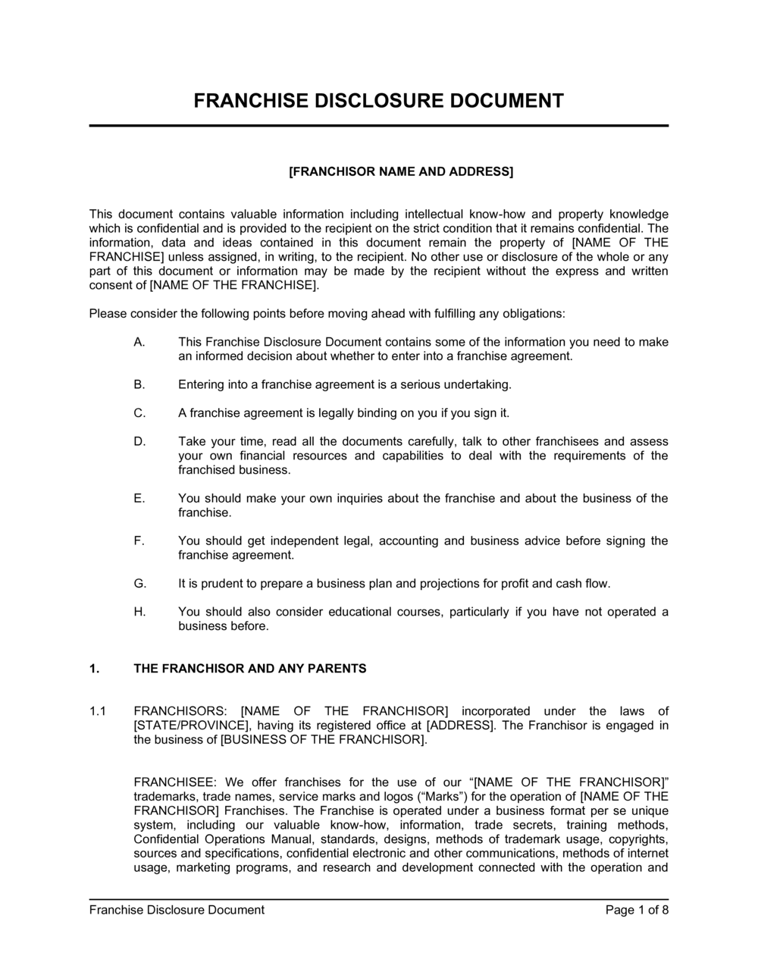
Franchise Law & FDD
Franchise Rule:
- A federal regulation enforced by the Federal Trade Commission (FTC) that requires franchisors to provide prospective franchisees with a comprehensive Franchise Disclosure Document (FDD) 14 days before a franchisee signs an agreement or pays money.
Franchise Disclosure Document (FDD):
23 categories of required info.
Must be provided before contract signing.
Protects franchisees from incomplete information.

Slide 33
Support Systems: Incubators, Accelerators, Ecosystems
What helps you succeed once you choose a pathway?
Incubators – Think: Daycare (safe, long-term)
Long-term support: space, training, mentorship.
Example: Food innovation hubs providing shared kitchens.
Accelerators – Think: Boot camp (short, intensive)
Short, intensive programs, often equity-based.
Example: AgTech accelerators in Colorado funding drone startups.
Entrepreneurial Ecosystem:
Networks of entrepreneurs, mentors, regulators, investors.
Example: Fort Collins food innovation network linking CSU, farmers, and startups.

Slide 34



Recall (Week 5) How Incubators & Accelerators Help
Programs exist to lower the cost, time, and risk of starting new ventures.
Provide shared space, basic resources, and access to mentors to build a capable team.
Guide funding estimates, connect ventures with grants, investors, and competitions.
Offer market intelligence, legal/regulatory support, and peer learning.
Help validate the idea technically and legally through expert review and testing.
Support customer discovery, refine the venture’s “why us,” and identify reachable markets.
Advise on pricing, distribution channels, and strategies to reach first customers.

Slide 35

Which pathway (create, acquire, franchise) would YOU choose for your first agribusiness venture, and why?

Slide 36
Summary
7.1 Describe the major pathways and structures for entrepreneurial ventures.
7.2 Explain the newness dimensions involved in creating a “new venture.”
7.3 Discuss the elements involved in acquiring an established venture.
7.4 Outline 10 key questions to ask when buying an ongoing venture.
7.5 Describe the underlying issues involved in the acquisition process.
7.6 Define a franchise and outline its structure.
7.7 Outline the benefits and drawbacks of franchising.
7.8 Explain the franchise disclosure document (FDD) as a key item in franchises.
7.9 Describe the elements involved with incubators, accelerators, and entrepreneurial ecosystems.

